Slide 1
Artificial Intelligence
Generative AI
Vivek Shastry
Sr Manager- Systems Engineering

Slide 2
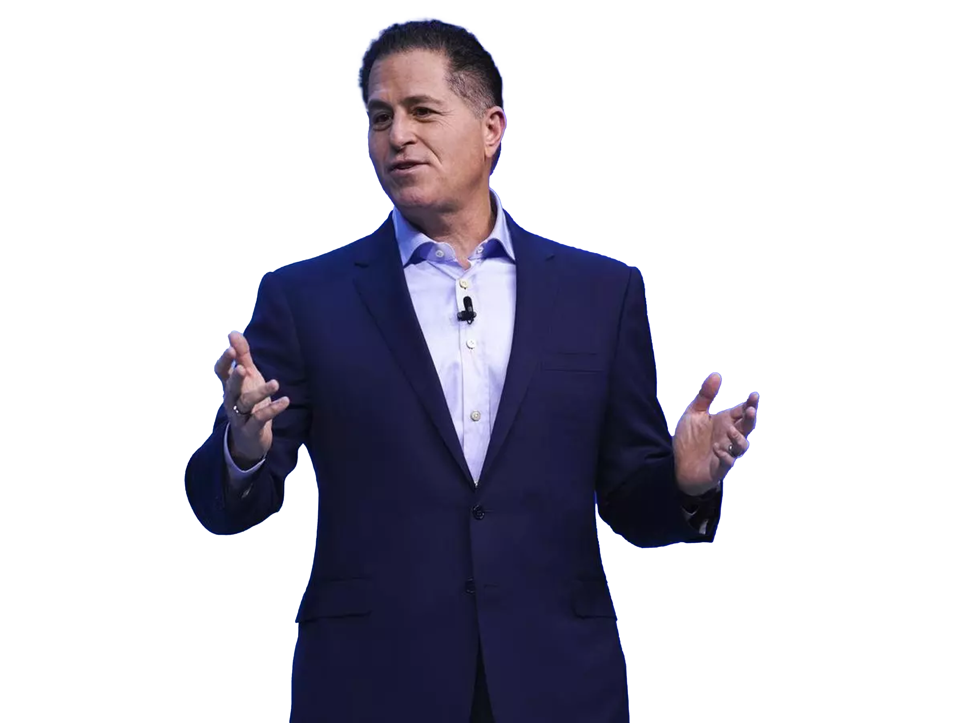
AI is the defining technology of our industry & our sector for the rest of the decade.
For us, this is all about data… which is really the fuel for AI.
— Michael Dell, Chairman & CEO Sep 2023
2
Copyright © Dell Inc. All Rights Reserved.

Slide 3
3
Copyright © Dell Inc. All Rights Reserved.

Slide 4
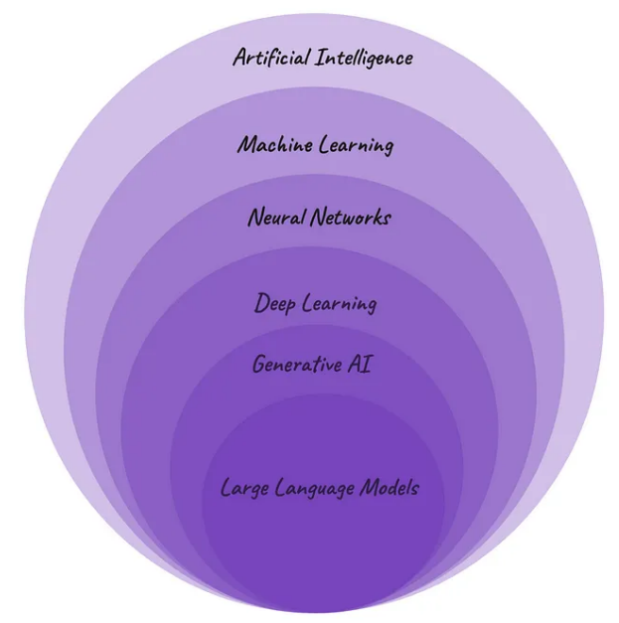
The AI onion peel
Artificial Intelligence (AI) deals with the creation and development of machines that think and act like humans
Machine Learning (ML) It is a program that trains a model from input data and then that trained model can make useful predictions from new or never before seen data. ML gives the computer the ability to learn without explicitly programming
Neural Networks (NNs) consist of interconnected artificial neurons organised in layers: an input layer, one or more hidden layers, and an output layer. NN are at the heart of deep learning algorithms
Deep Learning(DL) Any neural network with more than three hidden layers can be considered a deep learning algorithm. Having a higher number of hidden layers, DL models are well-suited for tackling complex real-world problems.
Generative AI (GenAI) a type of artificial intelligence that can generate different types of content - such as text, imagery, audio, video - based on what has learnt from existing content
Large Language Model (LLM) focuses on generating human-like text based on the patterns learned from vast amounts of textual data during the training process. Note the difference between LLM and ML. Large Language Model is a specific type of machine learning model specialized in natural language processing,

Slide 5
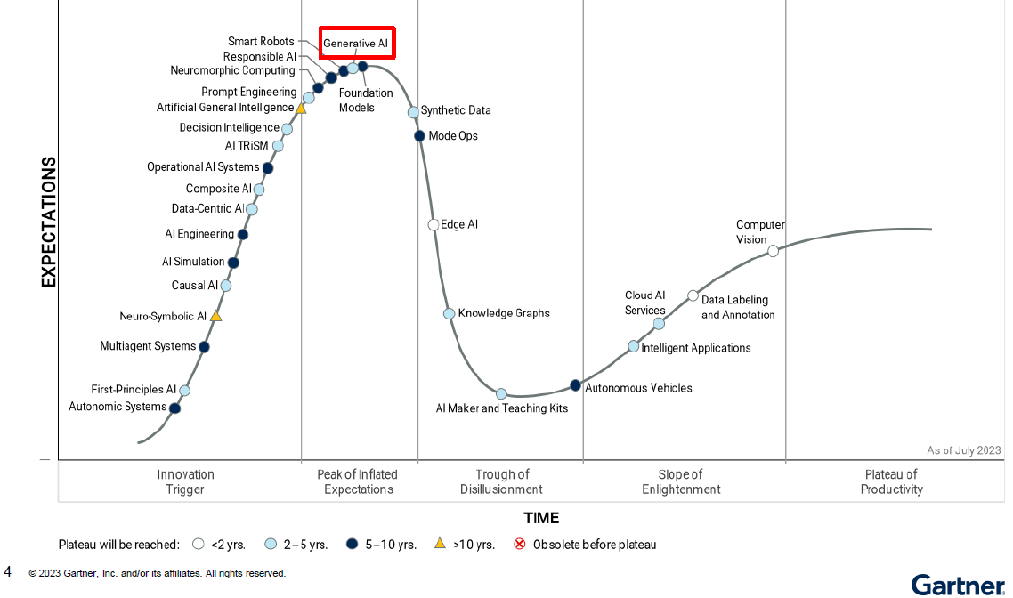
Gartner Hype Cycle – Suite of AI Tools

Slide 6
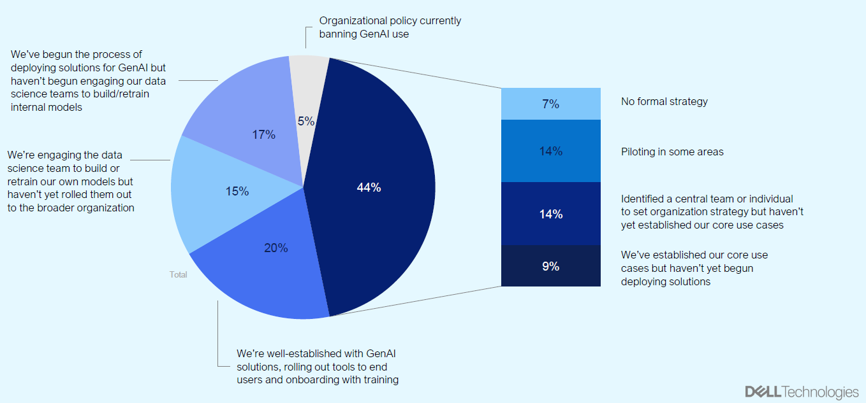
GenAI Journey
44% of organizations at early to mid-stage in GenAI journey

Slide 7
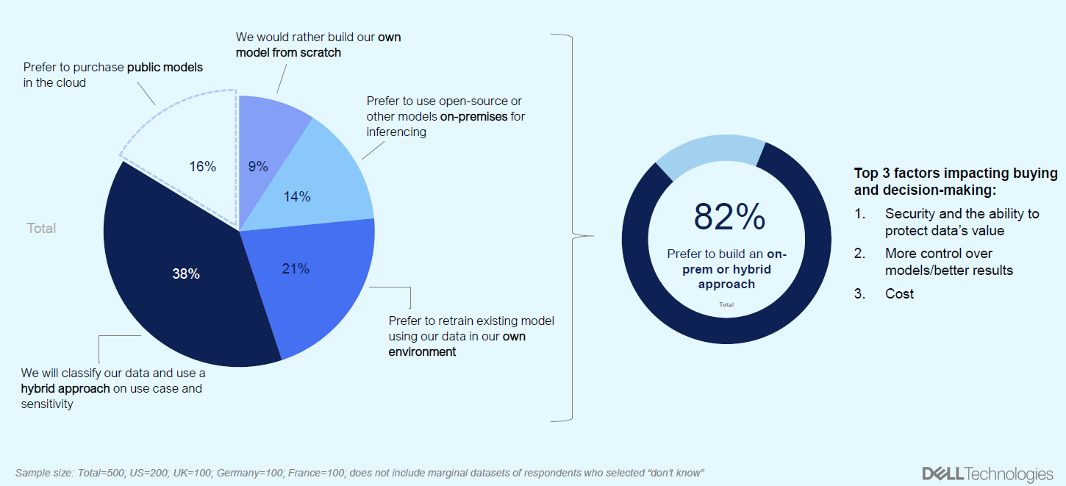
How organizations are approaching GenAI
38% will classify data and use Hybrid approach on use case and sensitivity

Slide 8
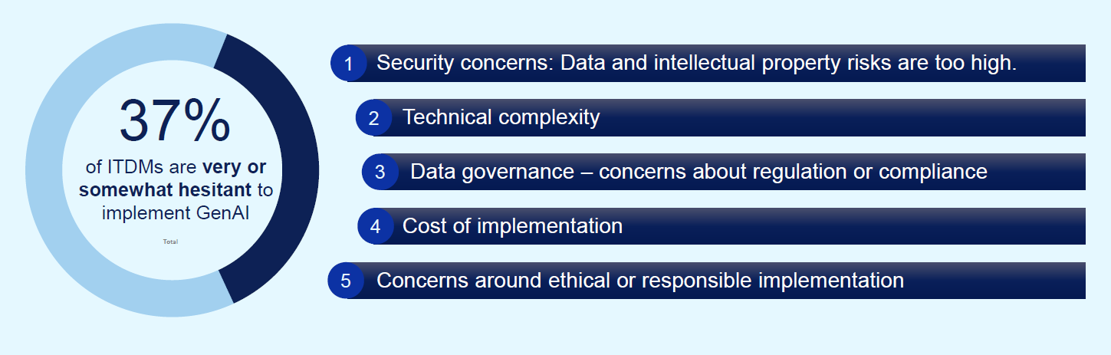
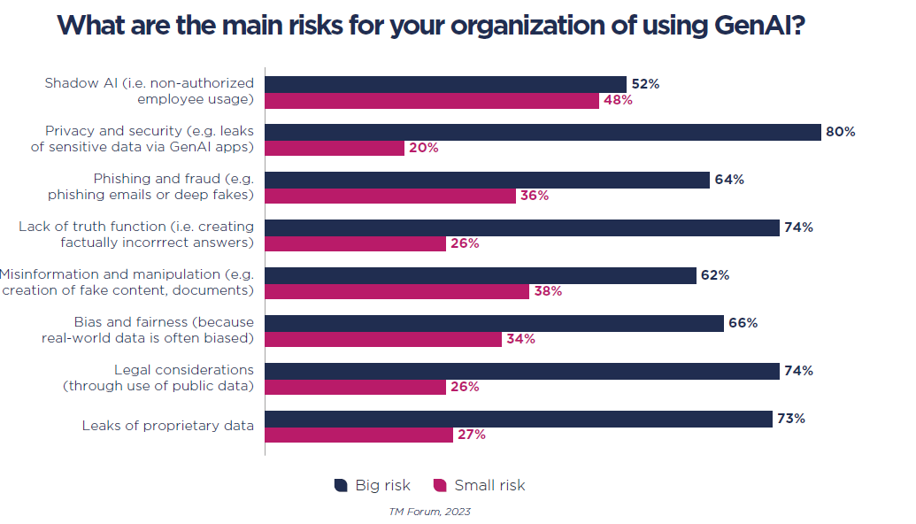
GenAI Challenges & Risks
Despite the excitement, some ITDMs report challenges and risks when it comes to GenAI adoption

Slide 9
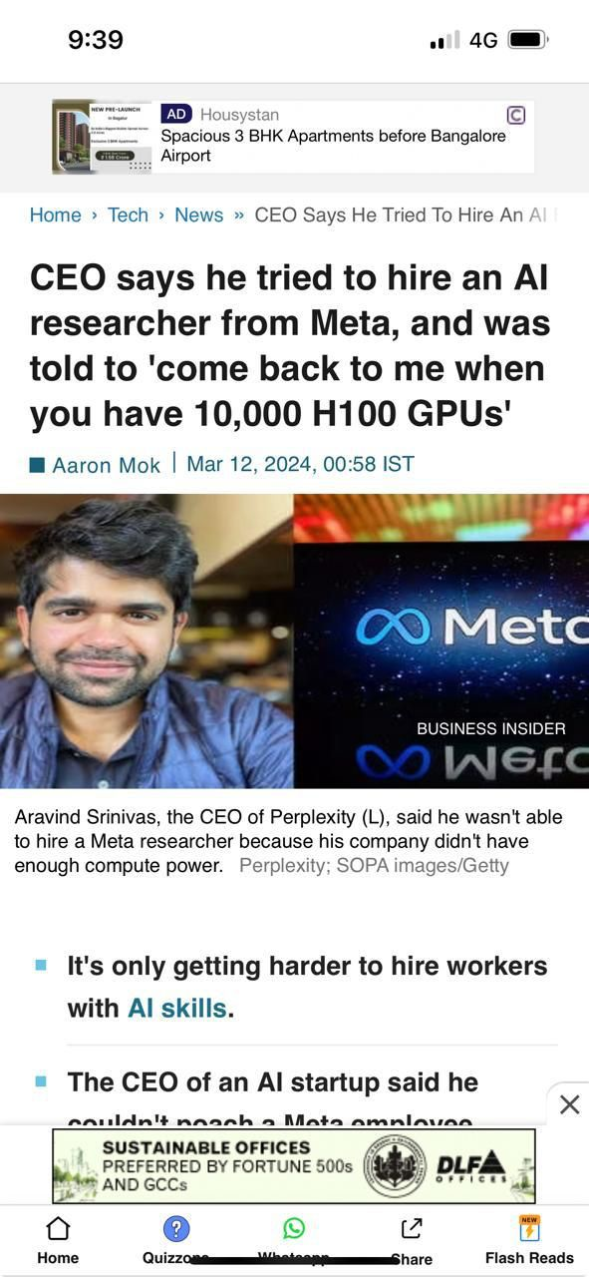

GenAI is Changing the world
Generative AI is projected to increase global GDP by $15.7 trillion annually by (Source: Forbes)
Generative AI is seen as a key topic in the boardroom, with 96% of executives recognizing it as such. (Source: Capgemini Research Institute)
By 2025, 30% of outbound marketing messages from large organizations will be synthetically generated, up from less than 2% in 2022. (Source: stateof.ai)
Within three years, executives foresee an 8% increase in sales and a 7% decrease in costs from generative AI adoption. (Source: Capgemini Research Institute)
68% of respondents in a survey said they are using AI tools, without first informing their bosses (Source: CIODrive)

Slide 10
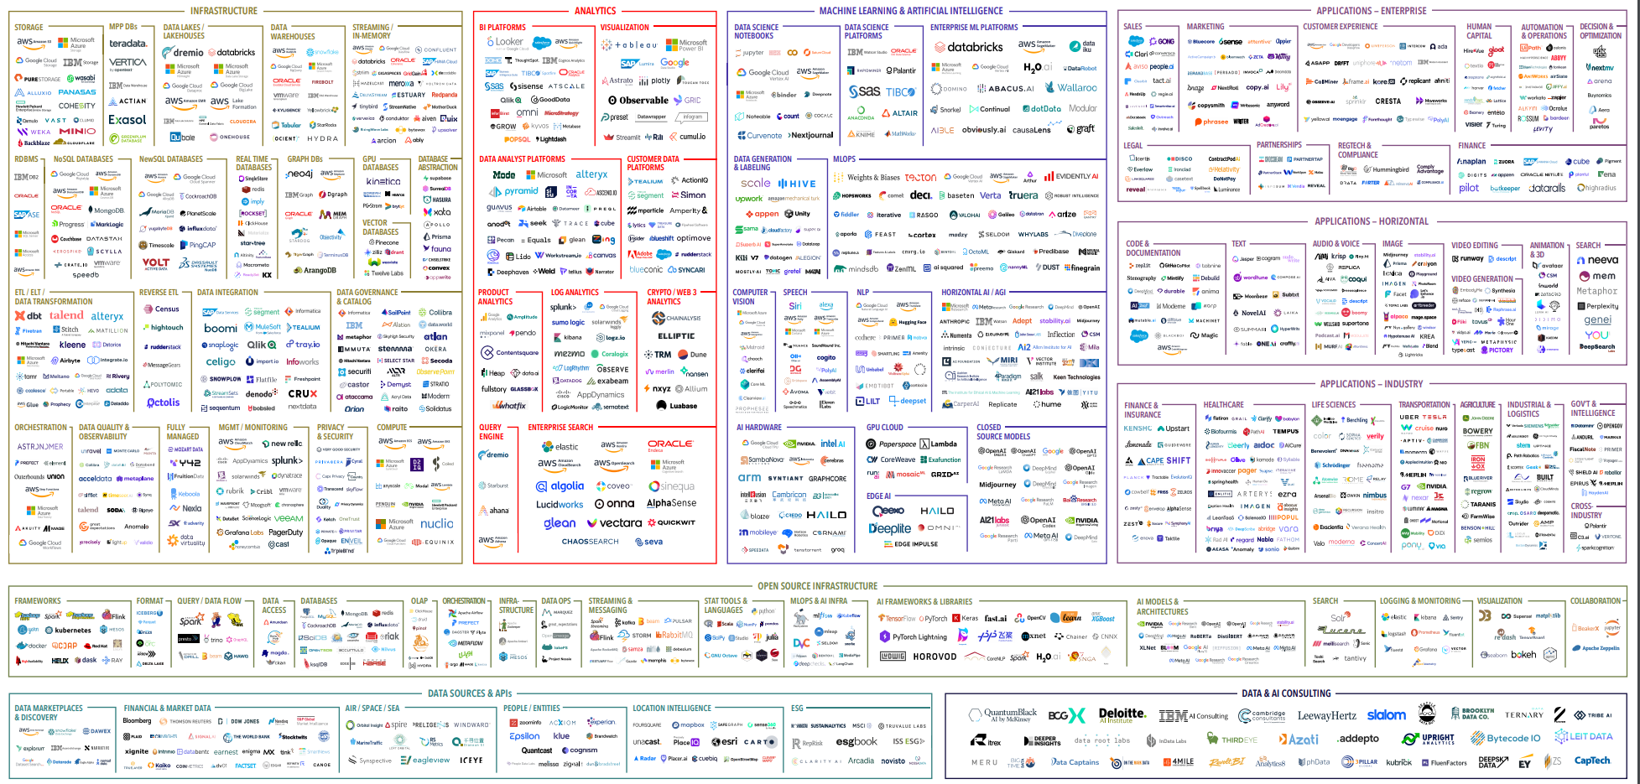
Analytics
AI Software
Infrastructure
Open Source
Data Management
Consulting

Slide 11
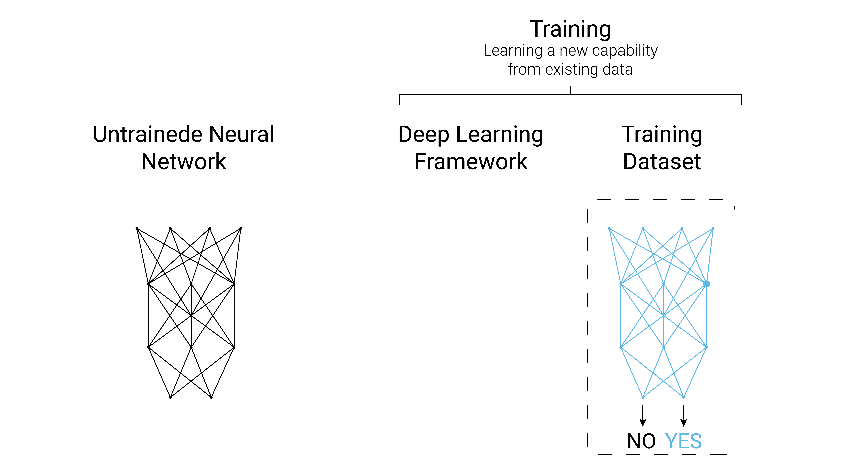
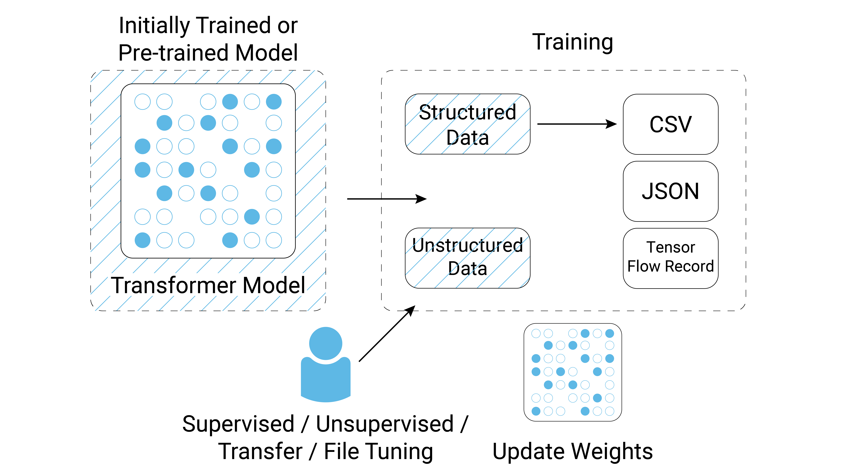
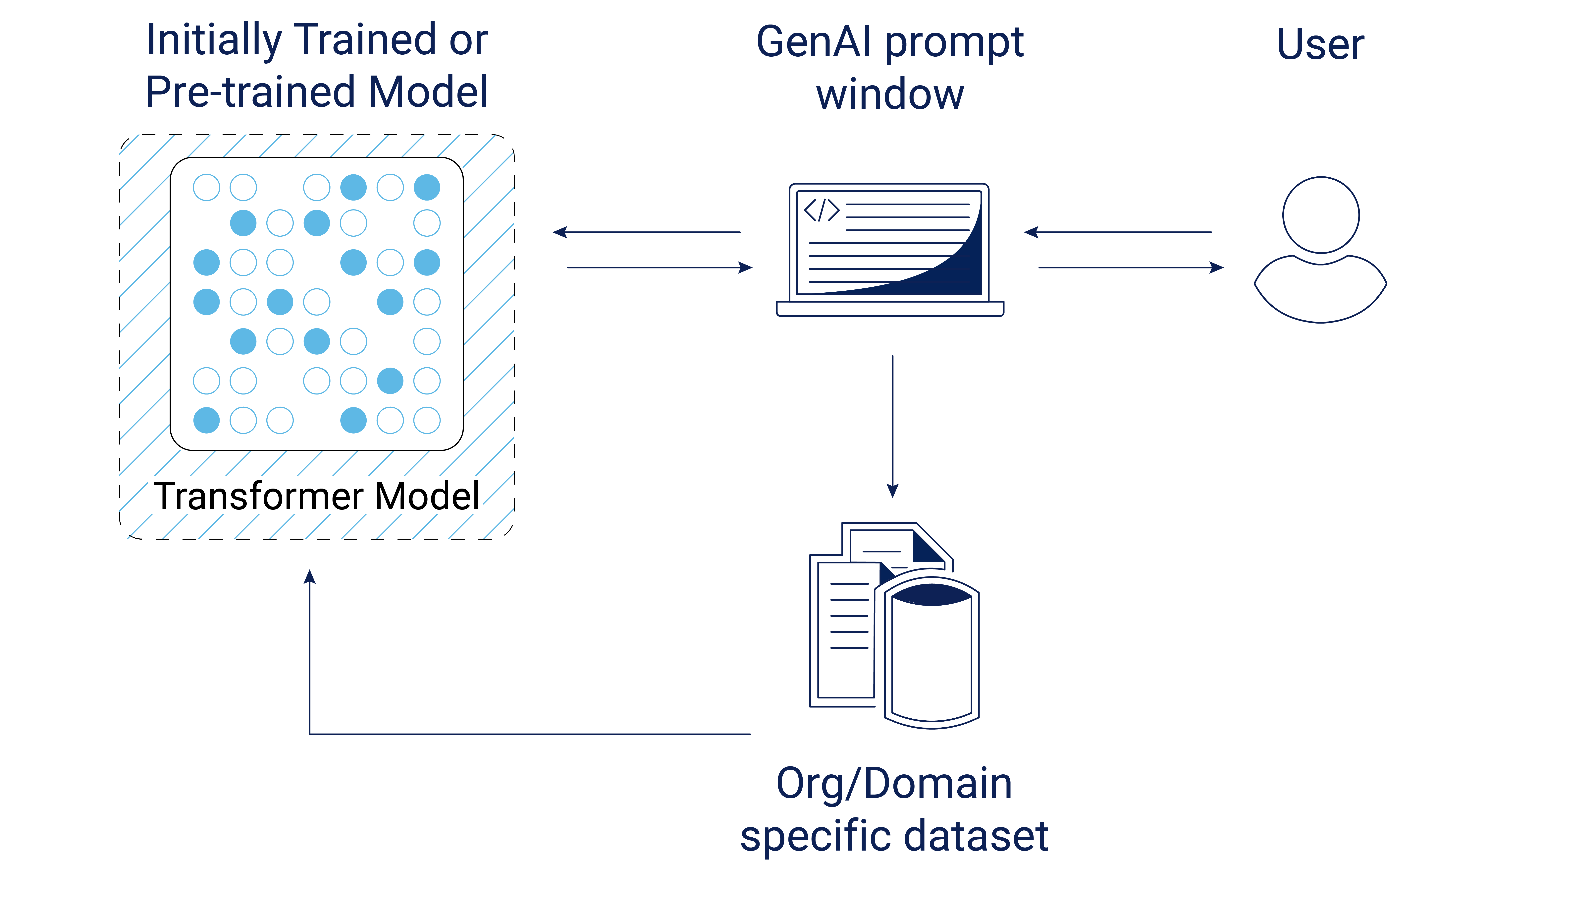
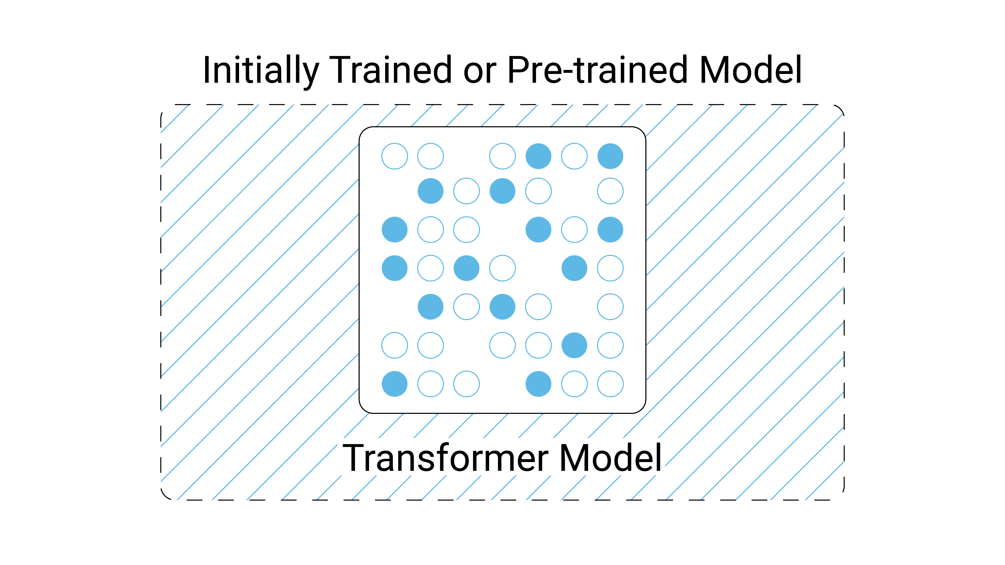

AI deployment patterns and their implications
Enterprise “Sweet Spot”
Untrained neural network
Model training
Fine-tuning
Prompt Engineering/RAG
Pre-trained model / Inferencing
Each pattern offers its own value and requires corresponding effort to unlock, optimizing for your use cases is critical

Slide 12

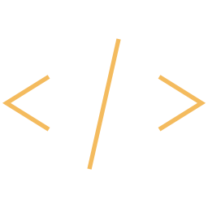
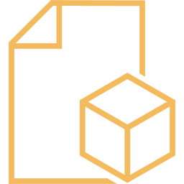

Common GenAI use cases
Content creation
Natural language search
Code generation
Support assistant
Design and data creation
Document
automation
Notes:
First off everything starts with use cases so we need to discuss that, as these areas are the general high level use cases you may want to explore.
What we’ve seen in the research is typically these are the top 6 horizontal use cases:
Content creation (marketing mostly, though sometimes contracts or other things)
Natural language search (internal within the enterprise)
Code generation – using natural language prompts to write code and help with unit testing and drafing documentation
Virtual digital assistants (call center and self-services (support))
Design and data creation – the ability to create synthetic data or creative imagery
Document automation - (summarization, routing (automating policy docs)

Slide 13
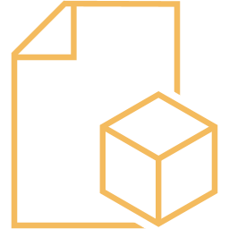
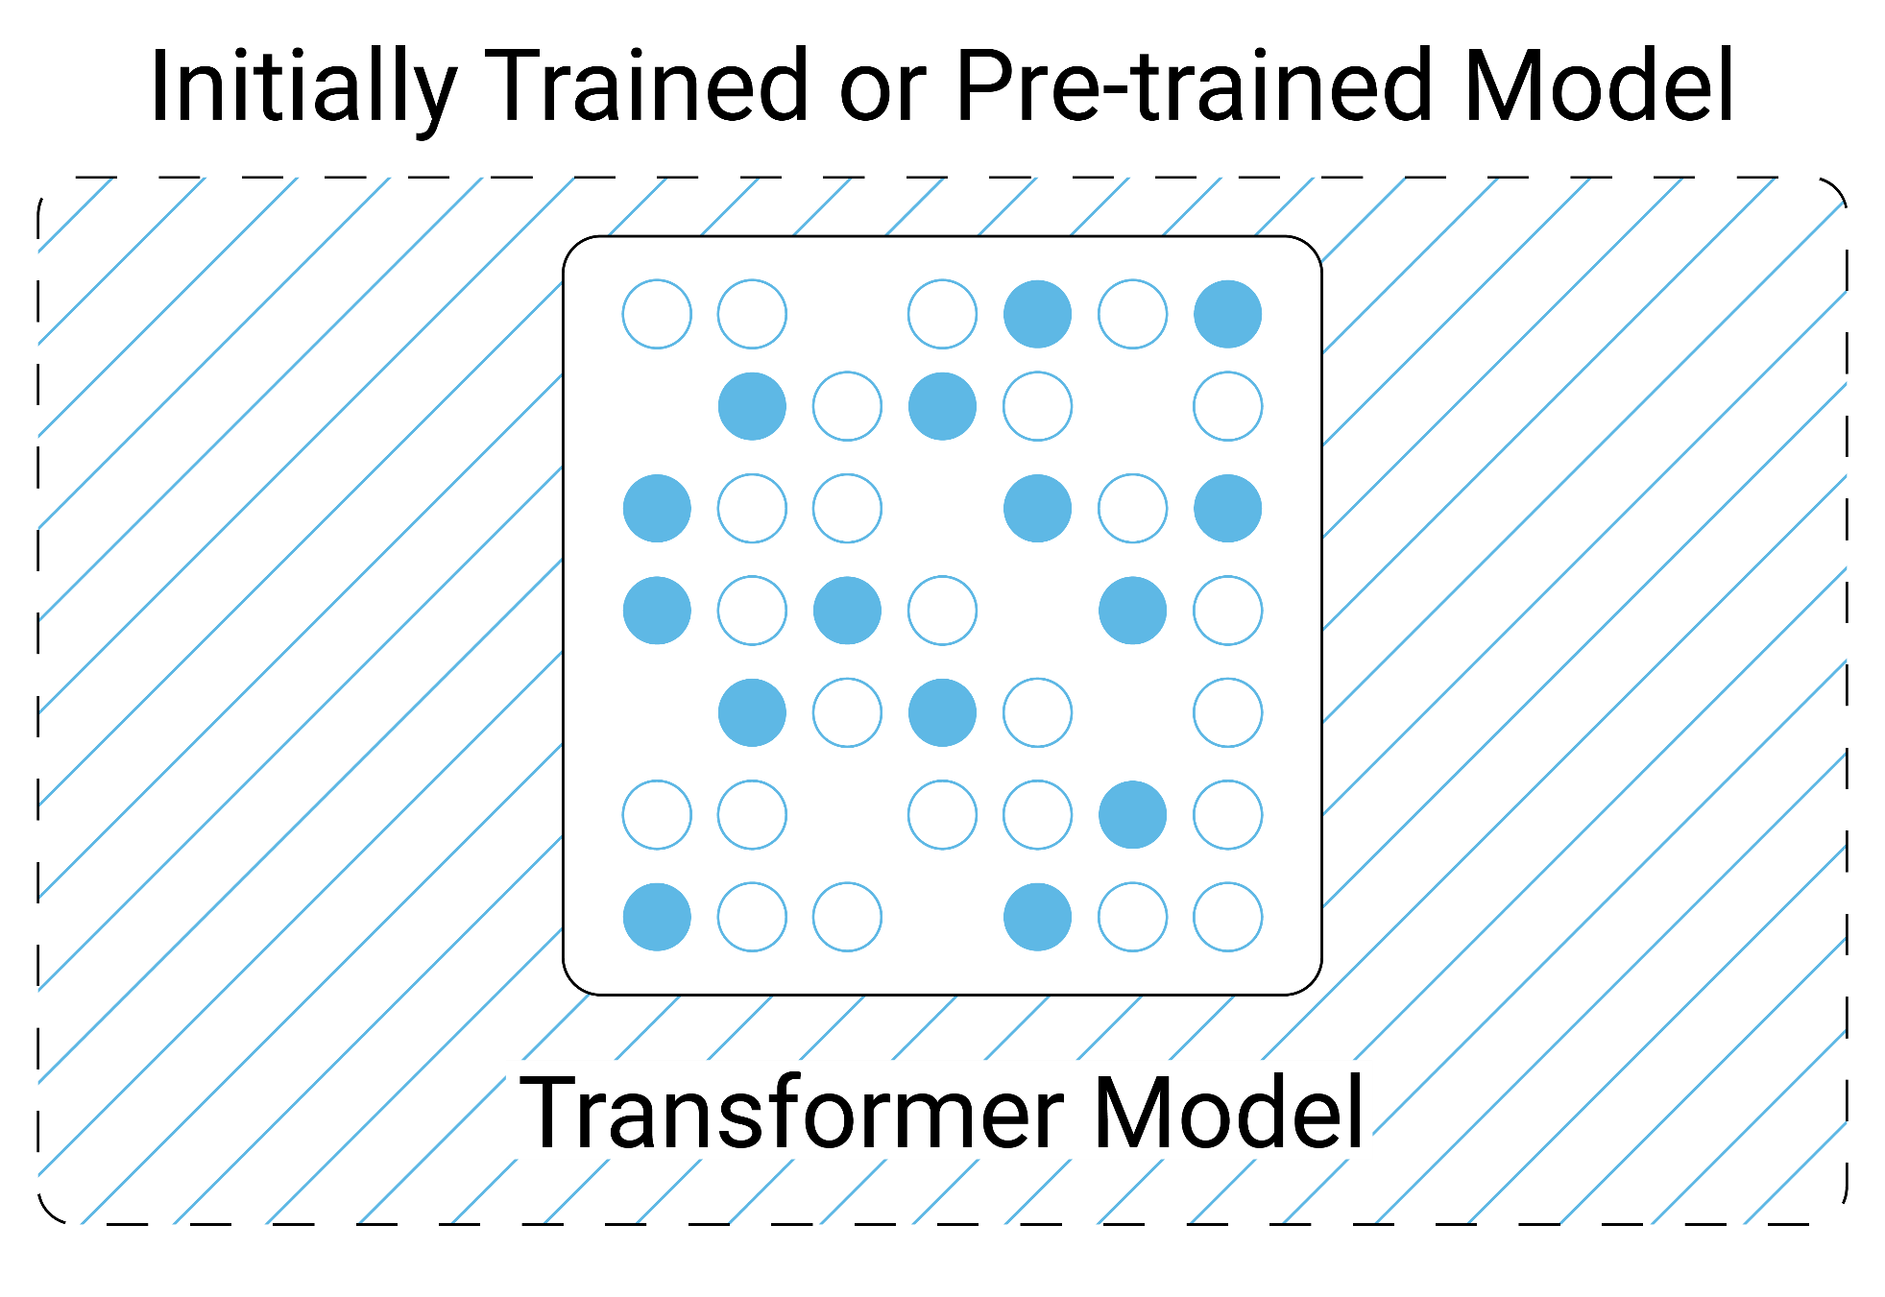
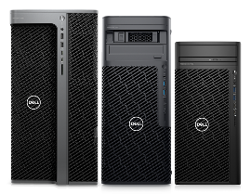

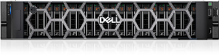
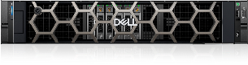


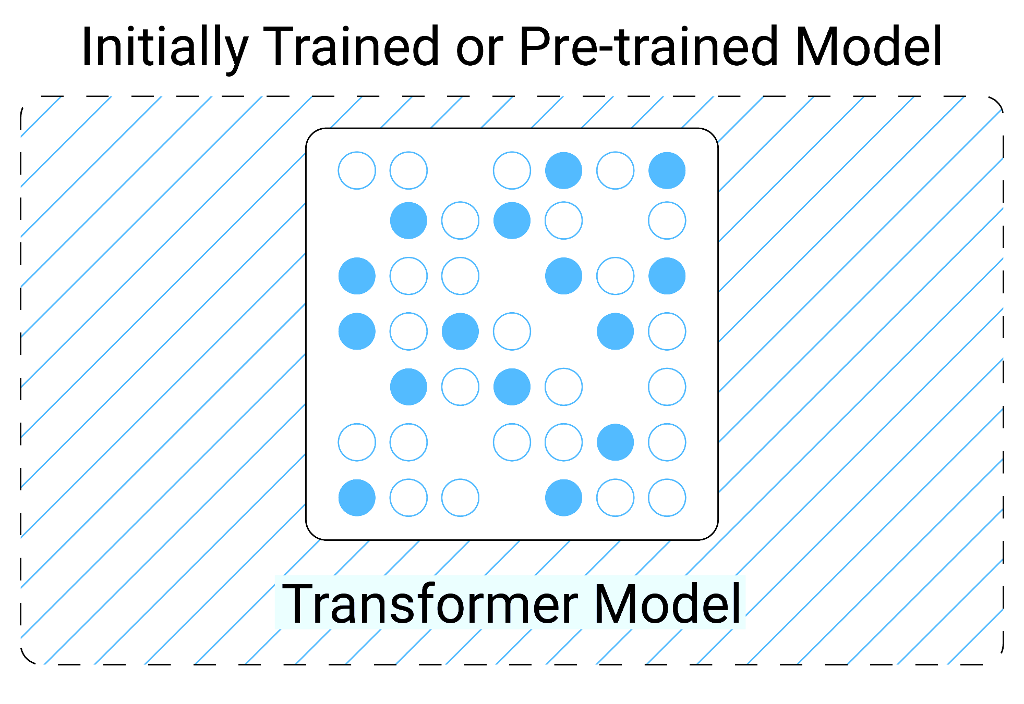




Use case example | Departmental document automation
GenAI purpose
Benefits
Use case
Users
Infrastructure investment
Why Pre-trained Model?
Document
automation
Analyzes large amounts of information to find or articulate a result (interpretation and synthesis)
Translates information for new audience
Includes additional context
Sales / marketing
Internal users
# of users
Etc.
Faster education in a new topic or domain
Can be used to refine data for new audiences
Helps standardize, format, classify, review and/or organize documents
Enhances productivity
Pre-trained model / Inferencing
AI model doesn’t need context
Existing LLMs operate at passible levels
No data science required
Modest hardware footprint required
XPS 15
Precision
Series
PowerEdge R-Series
OR
OR
Transformer Model
User
Prompt
Initially trained or pre-trained model
Result
Laptops
Workstations
Servers
Want help?
Deployment
Advisory
Data Science
Notes:
We start with inferencing using a pre-trained model. In this case the ask here was for a departmental document automation system. Basically these types of systems analyze large amounts of information to find and articulate the result. They can also be used for educational purposes like training a worker on a new domain or function of the job they are not familiar with. They can also be used to translate material for different audiences like taking a security report and putting it into context for a CEO who cares about very different things.
The main benefits here are the ability to get someone up to speed on a topic, refine that content for the right audience, standardize or structure materials into a common format, and leveraging to enhance productivity.
In this example we determined that inferencing with a pre-trained model because we felt it delivered enough value for these tasks and allowed us to reduce the infrastructure and data science requirements. Others might feel a different model is needed, this comes down to what capabilities are needed and what our investment appetite is.
What is interesting is simple inferencing depending on where its deployed, the size of the model, and the number of users accessing it can be ran on relatively modest hardware compared to our other GenAI patterns. This could take the form of something like Microsoft co-pilot running on a laptop. It could also be a more robust model running on a workstation or some servers and this is because inferencing is not nearly as GPU intensive as some of the other patterns.

Slide 14

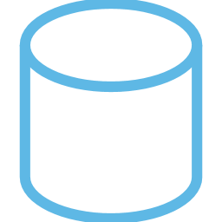


Use case example | Content creation
GenAI purpose
Benefits
Use case
Users
Infrastructure investment
Why RAG?
Content creation
Support IT staff and Service Reliability Engineers (SRE) responding to help desk tickets
Utilize info from historical ticketing databases to understand past context and provide recommendations
IT
Internal users
# of users
Etc.
Identify, learn from and extend best practices
Improves the speed, accuracy and/or completeness of recommended actions
Captures your organization’s voice and context to deliver brand-aligned responses
Model Augmentation with RAG
Provides contextually aware answers
Unique patterns have been established based on institutional trends
No data science needed but keeps humans-in-the-loop (HITL)
XPS 15
Precision
Series
PowerEdge R-Series
OR
OR
Transformer Model
Domain-specific Dataset
User
Prompt
Initially trained or pre-trained model
Laptops
Workstations
Servers
Want help?
Deployment
Advisory
Data Science
Notes:
Now we move onto Model Augmentation with Retrieval Augmented Generation or RAG. In this case we were looking at content creation. This use case could be anything from sales and marketing, to legal, to IT. In this case we have support IT staff and SREs who are responding to help desk tickets. They need a way to analyze historical data from their ticketing databases to understand past context and how best to respond to what they are seeing now, and potentially write documentation for remediation next steps.
With content creation augmented with RAG you’re able to identify, learn, from and extend best practices. It also generate recommendations and or provide content at lightning speed and provide more accuracy and completeness because it’s been augmented by your data. Last in the case you have a specific way you deliver services, or a brand voice this can help you ensure the Generative AI is acting consistently with your policies and practices.
In this example the reason RAG was chosen over simple inferencing was the added context the machine needed to stay aligned with this use case. We also wanted to prove this out relatively quickly RAG is a great PoC type technology. There are some limitations though and some organizations might feel like they could get better content creation if they change the logic in how transformer thinks.
Like inferencing RAG can be a pretty simple deployment with laptops, workstations, or servers running the model and having it pointed at a Vector Data Base that might be the front end of a larger structured or unstructured storage system or a data lakehouse.

Slide 15

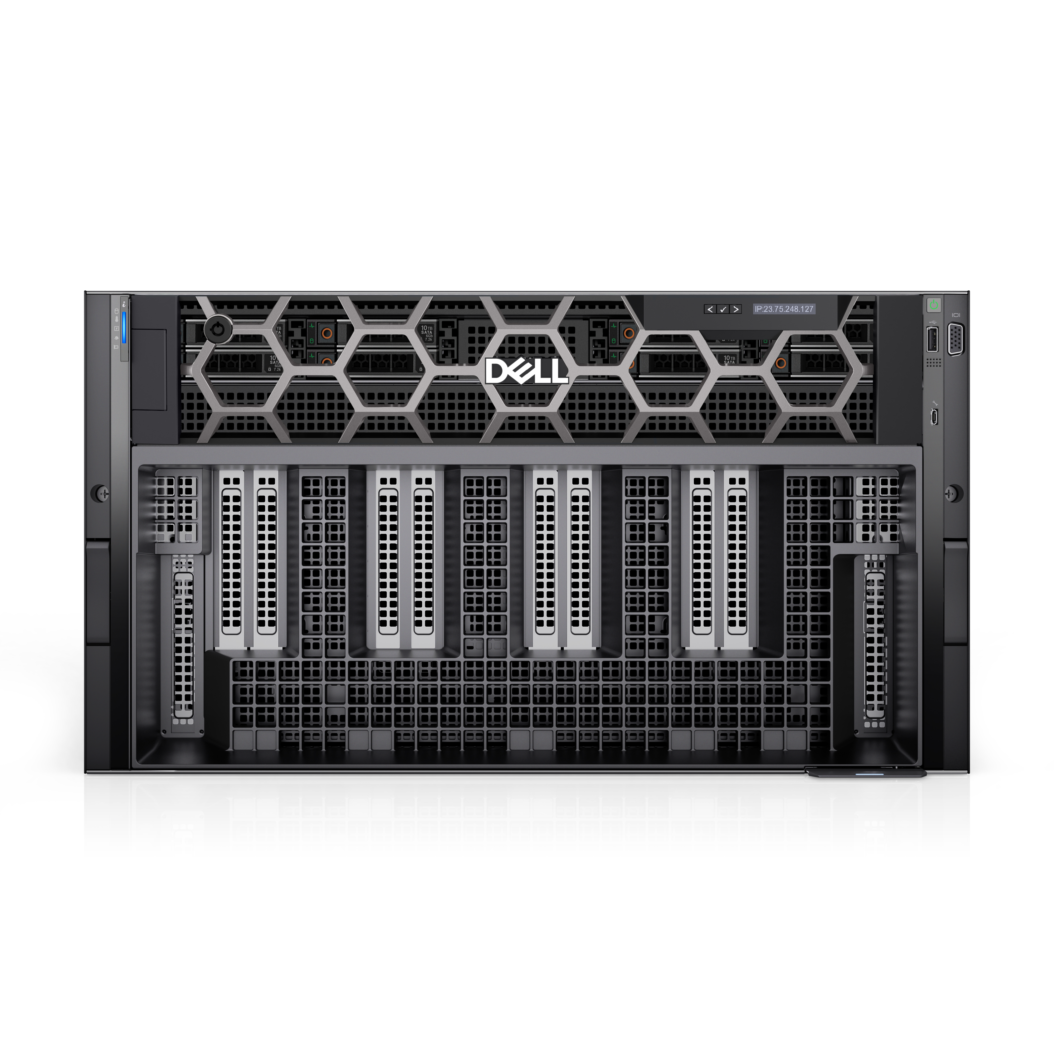
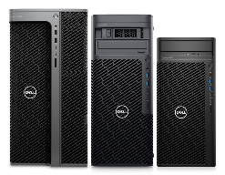
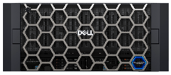
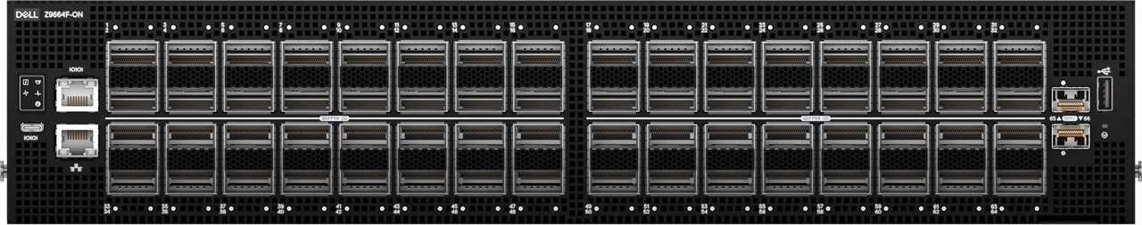
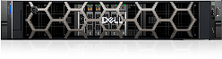
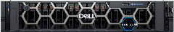
Use case example | Support assistant
GenAI purpose
Benefits
Use case
Users
Infrastructure investment
Why fine-tune an existing model?
Support assistant
Deliver 24x7 support via online kiosk without humans-in-the-loop (HITL)
Provide context-aware responses with tighter controls and guardrails in place
Improve CSAT and/or NPS
Customers
# of users
Etc.
Delivers more accurate, precise and complete results
Takes full advantage of your knowledge base
Frames answers in your preferred voice
Protects brand reputation
Fine-tuning
Need to protect the brand with strict guardrails
Provides more targeted and precise results
Data science resources are available
Reduces hallucinations
Dell Validated Designs
PowerEdge XE-Series
ECS
Precision
Series
+
PowerScale
Transformer Model
Training
Update weights
PowerSwitch Z-Series
User
Prompt
Initially trained or pre-trained model
Structured Data
CSV
Networking
PowerEdge R-Series
Compute
Storage
Workstations
JSON
Want help?
Unstructured data
Tensor Flow Record
Deployment
Advisory
Data Science
Supervised / Unsupervised / Transfer / File Tuning
Notes:
Next up we have fine-tuning a model and using it for a support assistant. The reason we selected fine-tuning is that the support assistant we’re building is going to deliver 24x7 support via online kiosk without a human in the loop… aka our customers will be interacting with the model directly instead of an employee reviewing the work and updating before a customers sees it. In such a case there is greater concern for bias, hallucinations, and inaccuracies as they could cause reputational harm. For that reason we need the model to have that same context awareness but with tighter controls and guardrails in place for responses to reduce the chances of issues arising. With a model designed to answer questions more effectively the goal is to achieve greater customer satisfaction or a higher net promoter score.
The benefits of this support assistant are the ability to deliver accurate, precise, and complete results to the customer base. Leveraging the full knowledge base to provide timely responses. Framing the answers in the preferred voice and with the right business logic (for instance you might have two products that serve the same market but one may be more favorable due to the criteria of the customer, or because you think it is the superior of the two). And finally, and maybe most importantly as GenAI becomes a window into your organization it is important to build a model that reinforces and protects your brand reputation.
In this example fine-tuning was used in order to provide stronger guardrails and more predictability into how the AI would function. We needed the precision in the results that we felt could only come from updating the weights. And we were able to greatly reduce the possibility of hallucinations occurring with additional instructions.
Unlike our first two patterns this one is very GPU dependent so infrastructure that has been GPU optimized and the Dell Validated Designs are likely the best infrastructure to use for this. Additionally, with our data scientists doing a lot of model work it is also important to provide them with workstations that can handle these models and the machine learning that will be going on.

Slide 16


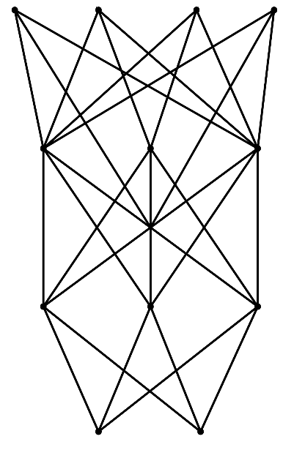
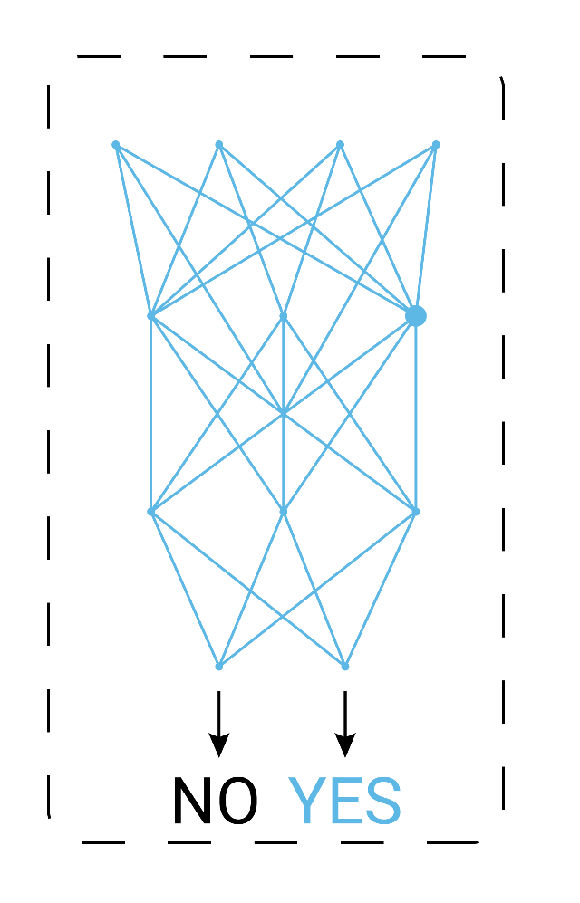

Use case example | Design and data creation
GenAI purpose
Benefits
Use case
Users
Infrastructure investment
Why create a new model?
Design and data creation
Solving high-specialized, bleeding-edge problems
Example: Drug discovery and design
Accelerate the process of predicting which parts of the genome may impact the growth of cancerous cells and how to treat them in a more targeted and localized manner.
Data scientists
Researchers
Doctors
# of users
Etc.
Offers transformational opportunities and demonstrates innovations
Introduces potential resale opportunities and/or differentiated offers
Eliminates the ‘black-box’
Model training
For use cases that off-the-shelf models are failing to answer accurately (even w/ fine-tuning)
Best, most accurate results
Most differentiated value
Dell Validated Designs
PowerEdge XE-Series
Precision
Series
ECS
+
PowerScale
Training
Learning a new capability from existing data
PowerSwitch Z-Series
Gather Data
Model
Untrained Neural Network
Deep Learning Framework
Training Dataset
Trained model
Results
Networking
Compute
Storage
Workstations
Iterate
Want help?
Deployment
Advisory
Data Science
Update weights
Notes:
Finally, we come to model creation. This is the most powerful and most accurate of the patterns but it is also the one with the most significant investments. Research has shown that most industries will avoid leveraging these models as fine-tuning offers enough value. However, for technology companies, telcos, and for very unique use cases this may be the pattern that is required. In this case we are looking at design and data creation but we’re doing so in a highly specialized field that is tackling the bleeding edge of Genomic mapping and cancer research. So we need a GenAI solution paired with machine vision to allow us to take a deeper look at patient care and find new drugs and treatment options for cancer as a result of analyzing. Now as you may imagine this is an incredibly specialized field, its very unlikely any Generative AI has been trained on a rich set of Genomic data I mean a single genome clocks in around 3TB for something like this we’re going to need a massive data set, and this is also very sensitive data so its unlikely we’re finding it in a public domain. Therefore we’re going to have to create the model and train it from scratch.
The benefits to this approach is it truly can lead to transformational opportunities and breakthroughs, and it showcases the innovation of your organization. In the case of technology companies and telcos its often being used as a way to differentiate your services and provide resale opportunities. It also eliminates the black-box concern of picking up a pre-trained LLM because you’re the one building it you’ll know a lot more about how it thinks.
Ultimately, we chose model training for this example because there just wasn’t a good answer with the other patterns for this use case. We know its going to take substantial infrastructure to do this work and more data scientists. But this was what was needed to achieve the objective.
Whereas with fine-tuning we saw the need for GPU optimized infrastructure we likely need a magnitude of that infrastructure for this use cases, and once again workstations equipped to support the massive size and complexity of building models from scratch.

Slide 17

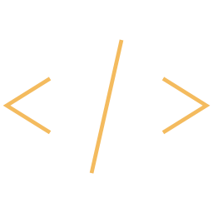
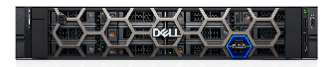
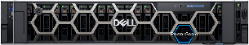

Right-sizing your AI investment
Goal
Business strategy and operations management
Product innovation and R&D
Manufacturing and supply chain
Marketing, sales and customer service
IT, HR and Finance
Users
Location
Dataset
•••
Use Case
Content creation
Support assistant
Natural language search
Design and data creation
Code generation
Document automation
Patterns
Pre-trained model / Inferencing
Model Augmentation
Fine-tuning
Model training
Investment
Dell Validated Designs
XPS 15
Precision Series
PowerEdge XE-Series
ECS
PowerEdge R-Series
PowerSwitch Z-Series
PowerScale
Laptops
Workstations
Servers
Compute
Network
Storage
Professional Services
Consultancy
Advisory
Data Science
Notes:
So we’ve discussed the different models, but what is important and how and when to use those models is really determined by what your organization is trying to accomplish.
Step one. Determine your objective.
This is what you want to do, achieve, what the outcome is. By understanding your objective / KPIs, that will help you determine the use case.
Step two. Identify the use case.
While use cases can be implemented through any AI patterns, certain use cases may benefit more from one pattern implementation versus the other. Determining the use case will also help you define and scope the effort.
Step three. Decide on the AI pattern (type).
With an understanding of your objective and use case, you can determine the right pattern to achieve the right results with the right balance of performance, risk and cost.
Step four. Right-size the investment.
Depending on the pattern you choose, you will know how to better scope and optimize the infrastructure footprint you’ll need to build.

Slide 18
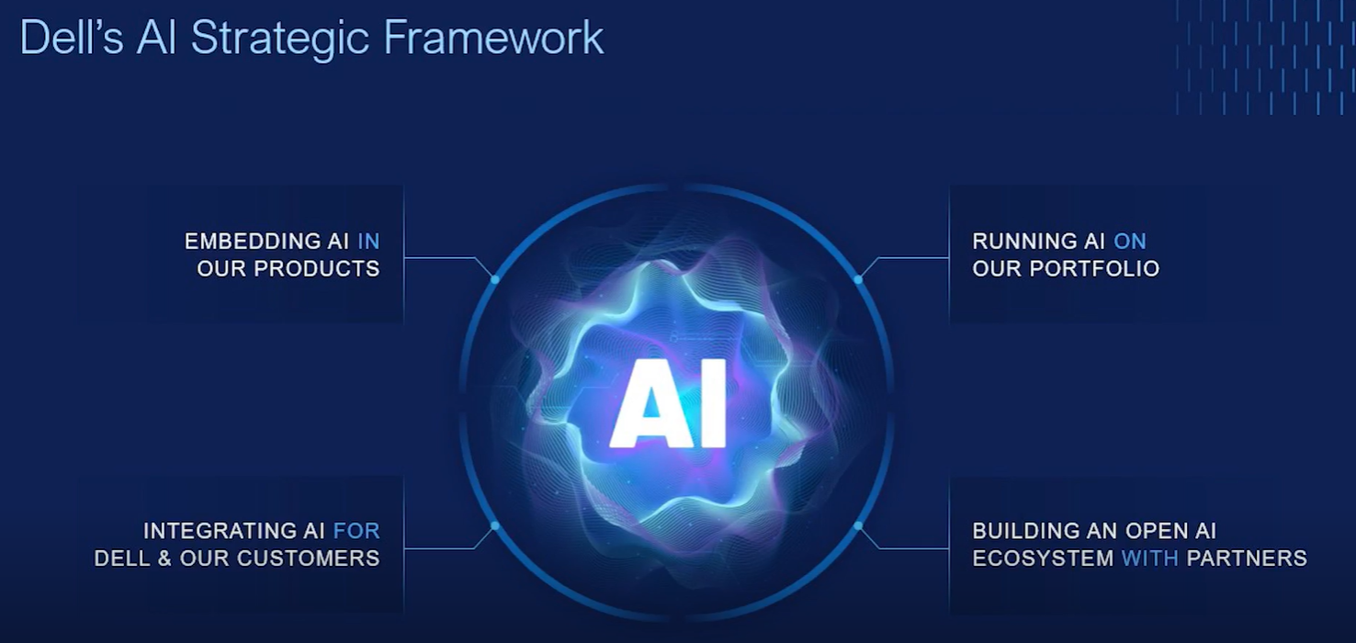

Slide 19
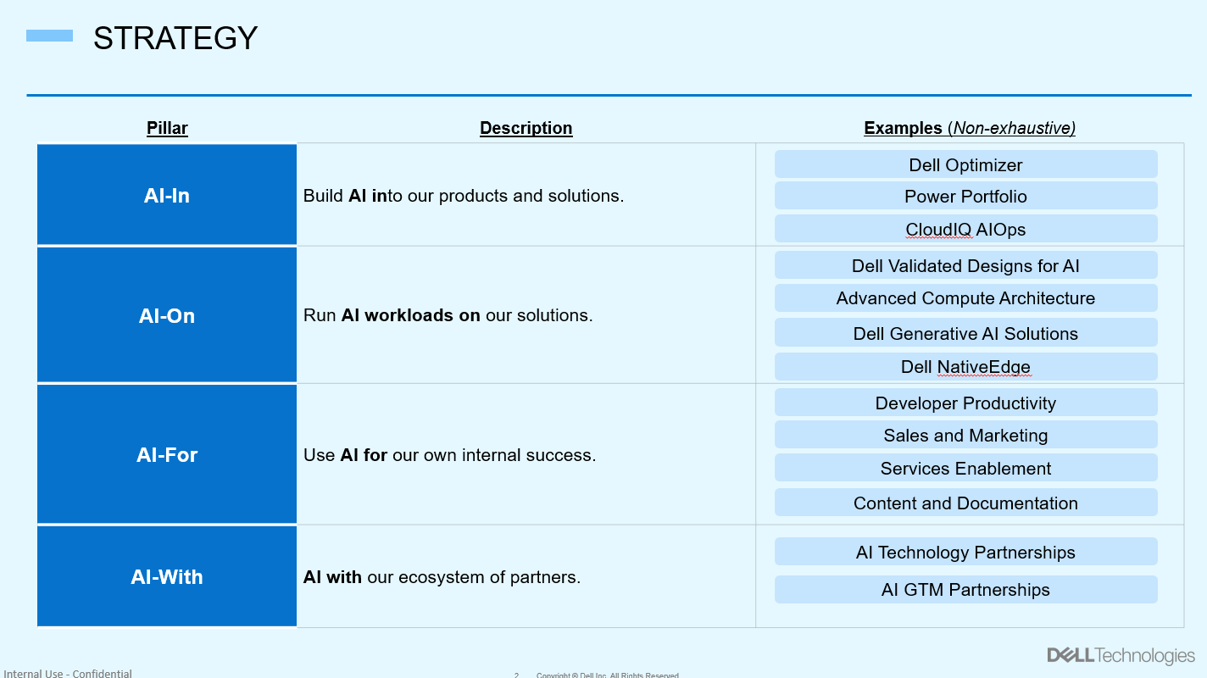

Slide 20
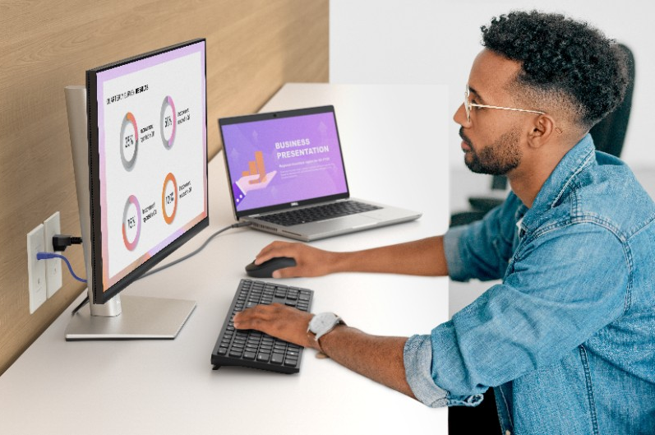



Dell Optimizer works around the clock to improve your PC experience
7:45AM
9:00AM
2:00 PM
4:45 PM
Presence Detection immediately welcomes you at work detecting your presence and opening your log-on screen.
Application optimization intelligently improves application performance based on how you use the app.
Intelligent Audio automatically reduces background noise and provides clearer sound on calls.
Collaboration touchpad puts frequently used conferencing functions right at your fingertips.
Network features optimize connectivity and prioritizes bandwidth for uninterrupted calls.
Intelligent Battery Extender makes system adjustments to help protect runtime when your battery is low.
Intelligent Privacy keeps on-screen data private with alerts and by texturizing your screen when an onlooker is detected; and will dim
when you look away.
Analytics (Precision & Rugged Only) end-user generated and shareable reports that show resource utilization and identify bottlenecks.
Optimize the life of your PC’s battery with advance charge and peak shift.

Slide 21
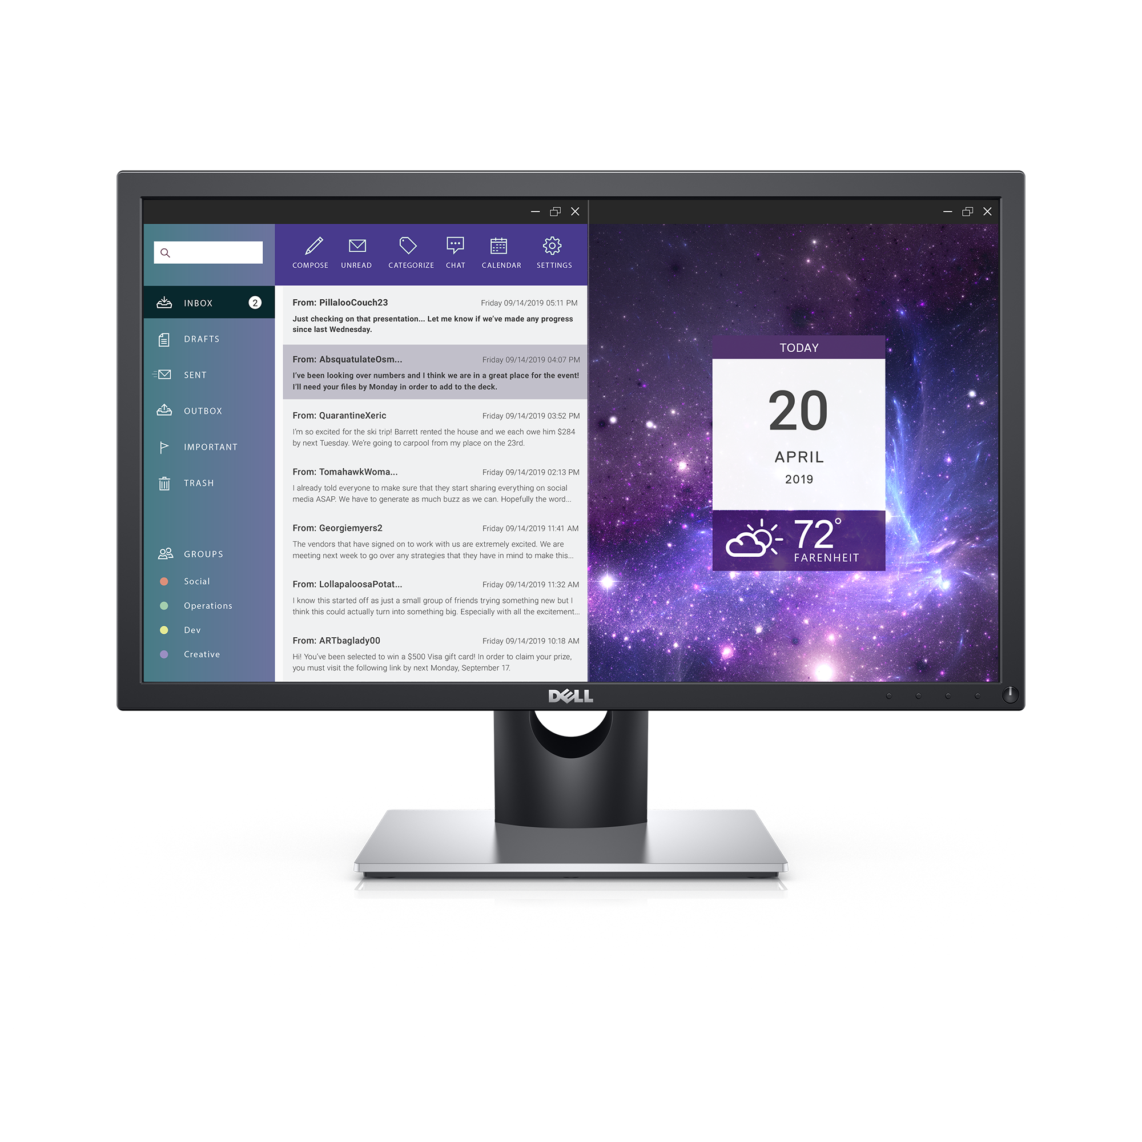
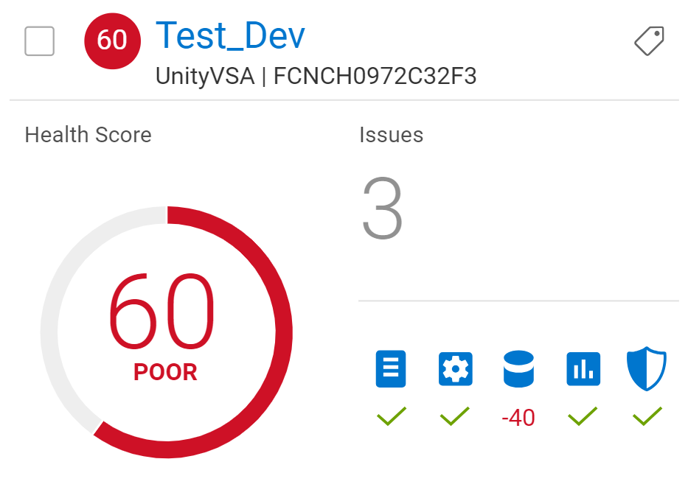

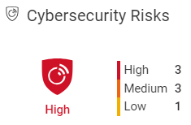
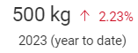
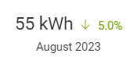

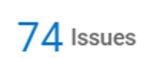
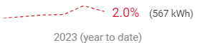

The evolution to next-gen AIOps: CloudIQ
Health
Cybersecurity
Sustainability
System Health
Carbon Footprint
Carbon Emissions
Energy Trend
Evolution from simple metrics to actionable insights
21
Copyright © Dell Inc. All Rights Reserved.

Slide 22
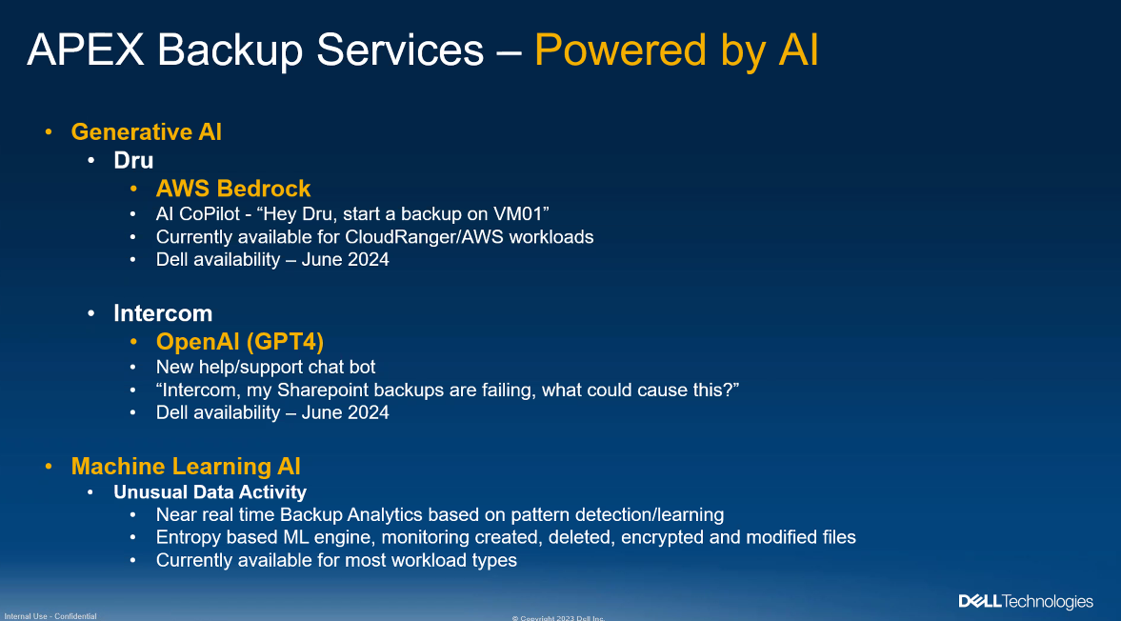
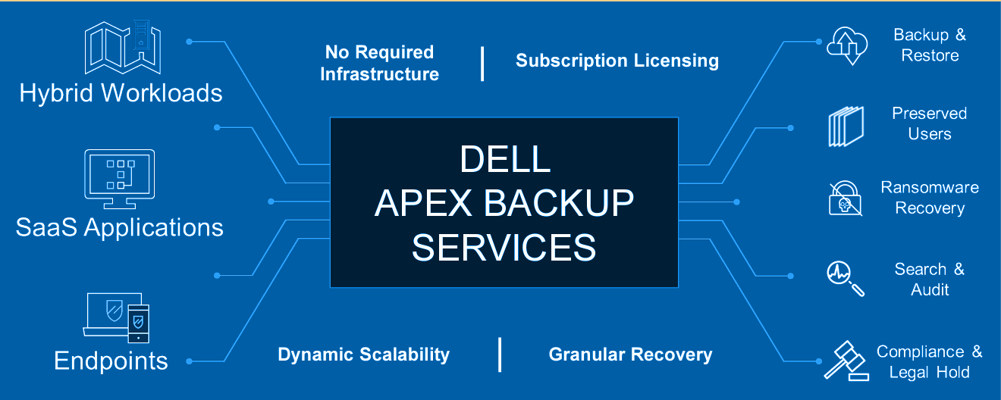

Slide 23
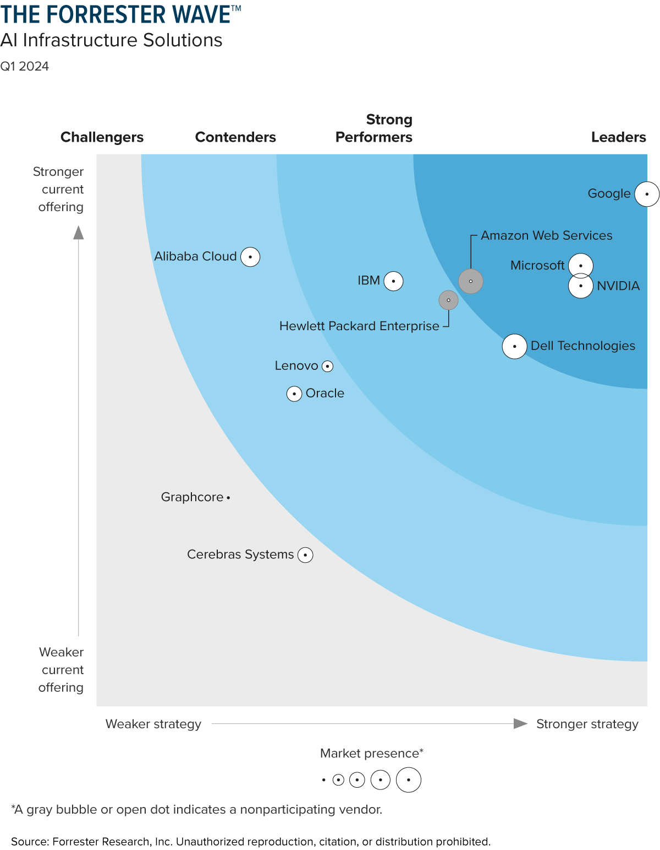
Forrester Report
The Forrester Wave evaluated the 12 AI infrastructure providers that matter most based on their current offerings, strategy and market presence. Here’s why Dell was recognized as a Leader:
Current Offering
Strategy
Market Presence
Notes:
Current offering. Dell received the highest scores possible in the criteria of architecture, configuration and training. Forrester acknowledges the complexities of running diverse AI workloads for organizations, yet Dell is dedicated to simplifying this with our “meaty” reference architectures. The Forrester report also cited Dell’s extensive portfolio, including our acceleration-optimized PowerEdge Servers and the wide range of storage solutions Dell offers, such as PowerFlex, PowerScale and more.
Strategy. Dell achieved the highest scores possible in the vision, partner ecosystem and supporting services and offerings criteria. The report states, “Dell’s superior vision is to offer the quickest, most integrated solution to enterprises for on-premises and colocation deployments.” The report also states, “Reference customers appreciate Dell’s exceptional level of service in quickly designing custom AI infrastructure that integrates with its existing IT infrastructure.”
Market presence. Dell’s significant market presence stems from its global reach and extensive customer base. According to the Forrester report, “Dell is a good fit for enterprises that wish to deploy on-premises or at a colocation [facility] and want an ongoing partnership to smoothly evolve AI infrastructure as demand increases.”

Slide 24
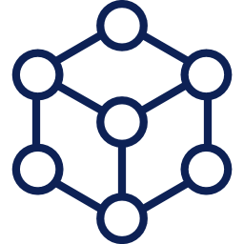
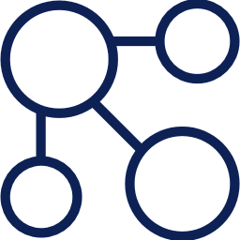
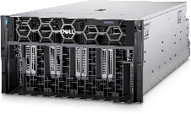
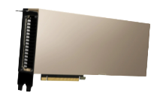



Dell Validated Design for GenAI with NVIDIA
Over 340k engineering hours spent on design, development and validation on GenAI solutions*
GenAI Frameworks
NVIDIA NeMo Framework
Community Source Models
AIOps & MLOps Platforms
NVIDIA Triton Inferencing Server
NVIDIA Merlin Framework
cnvrg.io
Infrastructure Management
NVIDIA Base Command Manager Essentials
Kubernetes
Enterprise Linux
Infrastructure
PowerEdge
PowerScale
ECS/ObjectScale
PowerSwitch
NVIDIA GPUs
Notes:
Taking a deeper dive into the Validated Designs – the first thing to call out is the work we’ve done to validate these configurations. Putting all of these different pieces together is a big challenge – and we’re making it easy – with over 340k engineering hours to ensure our customers have a streamlined experience
For compute (the bottom row) we now have the PowerEdge XE8640 and XE9680 validated for both Model Customization and Inferencing – in addition to the R760xa that included in the first validated design for Inferencing
We also have our storage components, such as PowerScale F600 that offer the scale and speed needed for operationalizing GenAI models, providing a foundational component across the lifecycle of an application, allowing customers to bring AI to their data.
For networking, we have high-performance and density, low latency Dell PowerSwitch Z-series for demanding compute and storage traffic environments.
The purpose of delivering these design guides is to take the guess work out of deploying workloads for our customers – essentially accelerating deployment and reducing risk with a documented approach – which ultimately speeds up their time to value.
So, with these guides for both Inferencing and Model Customization – we’re showing them how to deliver a better workload experience and enhance the value of their own data through fine-tuning of their large language model – which then also helps lower the cost of those optimization activities.
In addition, we’re wrapping this whole stack with our professional services – so wherever the customers need help, we’re there to lend a hand.
Validated Design key building blocks:
Generative AI Framework (based on NVIDIA AI Enterprise software)
NVIDIA NeMo is an end-to-end, cloud-native enterprise framework for developers to build, customize, and deploy generative AI models with billions of parameters.
In addition, we have also validated other open-source models such as Llama 2 and Stable Diffusion
AI/ML Ops Platform
Partner AIOps software for a smooth end-user experience, including interactive notebooks, experiment management, pipelines, and more. Example: cnvrg.io
NVIDIA Triton Inference Server, available with NVIDIA AI Enterprise, is open-source software that standardizes AI model deployment and execution across every workload.
NVIDIA Merlin is an open-source framework for building high-performing recommender systems at scale.
Infrastructure Management
NVIDIA Base Command Manager Essentials to deploy and reliably manage the AI clusters – together with Kubernetes and Linux
Familiar Dell management tools (such as CloudIQ and OpenManage Enterprise) delivering features such as lifecycle and power management, proactive monitoring and predictive analytics simplifying infrastructure operations
Hardware Infrastructure
NVIDIA H100 Tensor Core GPUs integrated into Dell PowerEdge platforms
Networking: High-performance NVIDIA Networking and high-density, low latency Dell PowerSwitch Z-series
Compute: PowerEdge servers (such as the Dell PowerEdge XE9680 or PowerEdge R760xa) designed for AI workloads, featuring improvements such as focus on acceleration, thoughtful thermal design, and multi-vector cooling.
Storage: PowerScale storage solutions (the F900 and F600 models) providing scalable and cost-effective file storage, and for object-based storage we have products like ECS and ObjectScale.

Slide 25



Dell Validated Design for AI
Conversational AI
Whitepaper
Kore.ai Named Leader in 2022 Conversational AI Gartner Magic Quadrant
Gartner Highlights Kore.ai Strengths
Business-user friendly. Extensive feature set for non-developers and non-data-scientists in no-code tooling
Most complete feature sets in the market for large enterprises
Easier to operationalize the solution within the owning business units
Innovation and excellence. Compared to competitors, Kore.ai has a larger development organization
Supports all major channels and languages
A single solution covers multiple use cases
Notes:
Demo on Pizza ordering

Slide 26






















Simplifying Data Management & Preparation
Great AI and GenAI results rely on great data
Semi-Structured
Unstructured
Data Lakes
Dell ECS
Any Data Any Type
Store, process, manage, secure data across on-prem, cloud, edge
Dell PowerScale
Open, Modern
Data Lakehouse
Query Federation
Federate queries & process data in place from any data source
Federated Query
Engine
High performance engines
High speed query engine for different workloads.
Relational DBs
Gather and Prep
Gather and prepare data for AI Ops and ML pipelines
Structured
Notes:
Such a reliance on the data truly elevates the role of Data Management and Data preparation. Great AI and GenAI results rely on access to great data. Getting your data house in order is a necessary first step to unlocking your organization’s potential with GenAI. Having access to an Open Modern Data Lakehouse that can process Semi-Structured, Unstrucutred and Structured data is key.
That means providing for any data type no matter where it resides edge, core, cloud.
Abstracting data silos with federated queries and the ability to process data in place.
Providing powerful and high-performance engines to accelerate queries for various workloads.
And helping gather and prepare data for being used in AI Ops and ML pipelines.

Slide 27
























Enabling an Open Data Ecosystem
Cloud enablement & market leading partners
Dell is building an open ecosystem of leading vendors & technologies in the data space.
Modern Architectures for Data Management
Bridging Edge to Cloud
Accelerating Compute to drive outcomes
Notes:
Data Management is a large and diverse market. No vendor can realistically solve all the problems. Customers need an ecosystem of technologies brought together to meet their needs wherever they are.
CLICK
Here is a sample of partners that Dell Technologies is working with to help customers with their data challenges, across a spectrum of core Dell partners as well as extended technology and GTM partners.
Cloud Native – we’re working to build interoperability between data stored on on-prem and leading cloud native players such as Snowflake so customers can use the best of breed cloud toolkits while maintaining control of their data.
Data Lake / Lakehouses – we’ve partnered with leading companies defining the future architecture of data lakes and data lakehouses and bringing an easy way to deploy and scale on-prem deployments
Databases – new database technology is evolving that is purpose built to accelerate analytical outcomes such as NoSQL databases for distributed processing, graph processing, multi-modal databases, etc.
Open Source – the data space has an increasingly rich open-source community which is at the forefront of innovation. We’re committed to bringing the best of breed to our customers manage their way through this complex web
Infrastructure – and finally, we partner deeply on establishing a robust infrastructure to deploy and manage the data stack. From colos such as Faction and Equinix to K8s and virtualization tech, customers can be assured of deeply integrated solutions that take the burden away from IT.

Slide 28







Bring AI to your data
The world’s broadest GenAI solutions portfolio from desktop to data center to cloud, all in one place¹
Data Management
Pre-trained model / Inferencing
Model augmentation
Fine-tuning
Model training
Integrated Solutions
Compute
Storage
Workstations
Purpose-built and tested for specific use cases
Reduces time-to-value and risk with validation of software, compute, storage and networking
Industry standard and open design
#1 worldwide in AI server plus storage infrastructure²
Delivering the industry’s best AI performance for Generative AI³
#1 worldwide in AI storage infrastructure²
World's most flexible⁴, efficient⁵ and secure⁶ scale-out NAS solution
Multicloud file, object and block storage support
#1 worldwide in Workstations⁷
World's most intelligent⁸ and secure⁹ PCs
Run GenAI operations 80% faster¹⁰
Professional Services
Consulting | Deployment | Support | Management | Education
Based on Dell analysis, August 2023. Dell Technologies offers solutions engineered to support AI workloads from Workstations PCs (mobile and fixed) to Servers for High-performance Computing, Data Storage, Cloud Native Software-Defined Infrastructure, Networking Switches, Data Protection, HCI and Services.
IDC Semiannual AI Tracker: Worldwide Server and Storage Revenue, 2021 and 2022 H1
Based on Dell analysis, August 2023. Dell Technologies offers solutions engineered to support AI workloads from Workstations PCs (mobile and fixed) to Servers for High-performance Computing, Data Storage, Cloud Native Software-Defined Infrastructure, Networking Switches, Data Protection, HCI and Services.
Based on internal analysis of publicly available information sources, February 2023.
Based on Dell analysis comparing efficiency-related features: data reduction, storage capacity, data protection, hardware, space, lifecycle management efficiency, and ENERGY STAR certified configurations, June 2023.
Based on Dell analysis comparing cyber-security software capabilities offered for Dell PowerScale vs. competitive products, September 2022.
IDC Quarterly Workstation Tracker, Q1 2023
Based on Dell analysis, November 2022. Dell Optimizer is the AI-based optimization software for commercial PCs and MyDell is the AI-based optimization software for consumer and small business PCs. Dell Optimizer is not available in OptiPlex 3000 series, Latitude Chromebook Enterprise, and Linux-based devices. MyDell is only available on new Inspiron, Vostro and XPS PCs beginning in 2023, as well as select models from 2021 and 2022. MyDell is not available on Alienware PCs. Feature availability and functionality may vary by model. For more details visit Dell Optimizer Availability Matrix and MyDell Feature Availability Matrix.
Based on Dell Technologies analysis, January 2020. Actual results may vary. See full whitepaper: https://www.delltechnologies.com/asset/en-us/products/data-protection/industry-market/dell-technologies-how-intrinsic-security-protects-against-business-disruption.pdf
Tests run on an Intel i9-12900K, 64GB RAM, Windows 11 Enterprise x64, NVIDIA driver 526.99. Test scores relative performance of PyTorch GNMT V2 Training tests sores. Preliminary results on pre-production hardware and software, final performance may vary.
Notes:
As you just saw there’s incredible diversity in use cases for Generative AI and with that comes a diversity in hardware requirements. And this is where Dell truly can support you wherever you’re at in your journey. We can bring AI to your data using the world’s broadest GenAI solutions portfolio from desktop to data center to cloud all in one place. Independent of what type of data science your use cases require.
We can help with integrated solutions that have been purpose built and tested for specific AI use cases. That have been validated across the software, compute, storage, and networking to reduce time to value and lower risk. All with industry standard and open designs.
We alo have a broad compute portfolio with PowerEdge R Series and XE series servers. Get the industries best AI performance for Generative AI with a portfolio that more organizations rely on from the #1 worldwide AI server plus storage infrastructure provider.
Pair that compute up with industry leading storage that delivers the world’s most flexible, efficient, and secure scale-out NAS to handle large data sets and offers extreme concurrency. You can also take advantage of Multicloud file, object, and block storage support with our APEX portfolio.
And finally whether you’re supporting your data scientists or running more modest models locally take advantage of the #1 worldwide leader in workstations. With the word’s most intelligent and secure PCs that can run GenAI operations up to 80% faster.
Supporting all these solutions is Dell Professional services which offer a variety of services from strategy to implementation to education to ensure your projects go smoothly.

Slide 29

Certification Program
Earn this industry first solutions badge by completing both the Dell Technologies Data Scientist & Data Engineering Optimize badge AND the NVIDIA Gen AI Large Language Models certification. Maximize your GenAI potential by combining Dell’s robust data science & engineering with NVIDIA's strong and practical knowledge of LLM application development and behavior customization
**Official Launch- 3d April

Slide 30
Known GenAI Efforts Across Dell BUs
Name | PowerAssist Digital Support Agent as a Service (DSAaaS)
Group | ISG
Use Case | Support for Customer Post-Sales Engineers
Source Material | Knowledge Base (KBs) Articles Service Request (SR’s) Equipment Logs Previously Solved Cases
Link
Contact | Craig Bernero
Name | APEX Insights
Group | Sales
Use Case | Sales Call Bot for Assistance with Pre, During, & Post Sales Calls
Source Material | Dell Public Information Initial Focus is only APEX Information
Link
Contact | David Schweighofer
Name | AI Jedi
Group | APJ Data Scientists
Use Case | Presales GenAI Support
Source Material | TBD
Link
Contact | Aruna Kolluru
Name | Clara
Group | Presales
Use Case | Digital Human
Source Material
Link | URL
Contact | Mike Shepard
Name | Project Jarvis
Group | OCTO
Use Case | Centralized Corporate GenAI Pilot
Source Material | All Dell Internal Data
Link
Contact | Ken Durazzo
Name | Customer Chatbot
Group | OCTO
Use Case | Provide Answers to Customer Presales Questions
Source Material | Dell Public Information
Link | Currently Offline
Contact | Megan Hyland
Name | Microsoft Sales Copilot
Group | Sales / Dell Digital
Use Case | M365 Integration to Salesforce.com
Source Material | Dell M365 Tenant Salesforce.com
Link
Contact | Bruce Sanchez
Name | Microsoft Copilot
Group | Dell Digital
Use Case | Microsoft Provided LLM
Source Material | Dell M365 Tenant
Link | URL
Contact | Jerry Loui
Name | Sales GPT
Group | Performance Analytics Group
Use Case | Sales & Customer Information
Source Material | SFDC Web Crawling
Link | URL
Contact | Anna Popova

Slide 31

Project JARVIS Presales Use Cases
Desired Outcome
A significant amount of Dell Presales effort is spent on researching available solution offerings to understand their capabilities and needed configurations to meet customer requirements
Reduce time for research → Better customer experience → Decrease time to revenue
Strategy
Align GenAI capabilities with Presales DADD Framework
Approach
Build a GenAI enabled tool that will facilitate discussion-based content discovery for the Presales community. Begin with a pilot environment and then move to a production environment to serve the global community.
Scope
Due to limited OCTO lab resources, the pilot will be broken up into multiple phases and will focus each phase on specific DADD use cases

Slide 32
Presales Technical Selling Framework DADD Campaign Overview
Listen
Collect
Research
Socialize
Discover
Analyze
Design
Defend
Question
Document
Interpret
Process
Validate
Build
Propose
Challenge
Discover & Analyze Client Information
Financial Information (10K, …)
Public Information (Partners, …)
Stakeholder Bio’s
Industry Competitors
Technical Industry knowledge
Understand Customer Environment
Dell asset information
Competitive landscape & insights
Customer health (Support Info, …)
Tech refresh targets
Review Customer Requirements
Business outcomes
Technical needs
Environmental constraints
Review similar customer proposals
Review Technical Requirements
Performance
Capacity
Availability
Validate with Customer
Solution requirements
Desired outcomes
Use of Sizing & Design Tools
Determine tool usage (Grabs, …)
Review tool output
Draw conclusions
Solution Alignment with Customer
Review study conclusions
Determine best fit options
Create recommended approach
Determine Solution
Needed solution functionality
Needed product(s) features
Reconcile Proposed Solution Design
Resolve overall solution gaps
Create detailed design
Confirm solution requirements
Document required integrations
Ensure customer compatibility
Perform design iteration
Create Technical Proposal
Needed Services
Bill of Materials
Technical benefits
Artifacts (As-Is, To-Be, …)
Review Proposed Solution Benefits
Technical Advantages
Business Value
Service offering
Commercial options
Address Competitive Threats
Provide competitive differentiation
Achieve Technical Win
Gather customer feedback
Perform proposal iteration
Achieve Customer Agreement
Customer validation
Create needed delivery artifacts
Governance through SFDC

Slide 33
Project Jarvis Estimated Timeline
OCTO SharePoint
Confluence
JIRA
Presentations
Meeting Recordings
Videos
External Research
Knowledge Base Articles
Service Request (SR’s)
Equipment Logs
Previously Solved Cases
Metric Information
Recommendations
Proposal Library
Customer Public Info
SEC Edgar
M365 Graph API
SalesWorks API
Pluggable LLM’s
Customer Public Info
Role RACI
Industry Knowledge
Service Requests
Knowledge Base
Sales Copilot
Equipment Logs
Product Sites
Solution Sites
Sales Information Sites
Dell Partner Information
Tool Output - TBD
TBD
PLEASE NOTE:
Every pilot phase will have (3) sub-phases
Acceptance by developers
Alpha Testing by group of 10 people
Scheduled (due to limited lab resources) beta testing by remaining team members
Phase 1 Data Ingestion
& Indexing
Phase 2 Data Ingestion
& Indexing
Phase 3 Data Ingestion
& Indexing
Phase 4 Data Ingestion
& Indexing
Phase 5 Data Ingestion
& Indexing
Phase 6 Data Ingestion
& Indexing
FY24
FY25
FY26
FY27
Pilot Phase 1
Presales Field
Enablement
Production Pilot
***
Production Release
***
Test User Training
Pilot Phase 2
GOAL:
Test system capabilities
USERS:
OCTO Community
GOAL:
All pilot phase capabilities to date
USERS:
All Global Presales Members
Select Sales Members
GOAL:
TBD
USERS:
Wide-Scale Rollout Begins
GOAL:
Dell products & solutions information
Technical specs on Dell portfolio
Competitive insights & differentiation
Partner ecosystem information
USERS:
100 Presales Members *
Test User Training
Pilot Phase 3
LLM Fine
Tuning ??
Test User Training
Pilot Phase 4
**
Pilot Phase 5
**
Pilot Phase 6
**
GOAL:
Tool Integration - TBD
TBD
USERS:
100 Presales Members *
GOAL:
Pluggable (LLM as a Service)
MS Copilot interface
SalesWorks Interface
SFDC Interface
Customer information
Dell asset information
Determine content refresh cycle
Exploring Live Optics Ingestion
Vertical & horizonal practices
USERS:
100 Presales Members *
GOAL:
Switch to New UI Interface
Pluggable (LLM as a Service)
MS Sales Co-Pilot integration
Power Assist integration
Accenture integration
Email, TEAMS,& OneDrive
Industry Knowledge & Trends
Role descriptions / RACI
Test access control & sensitivity
“How do I” process questions
USERS:
100 Presales Members *
GOAL:
Multi-language support
Metric Reporting
Proposal Library
Analyze Solutions Portfolio
Tool Integration - TBD
Ingest Power Assist information
TBD
USERS:
100 Presales Members *
* Number limited due to lab resources
** Pilot phase in proposal stage
*** Date is still being finalized

Slide 34












CASE STUDIES
Brands like yours changing the way they care for customers
Check out just a handful of our clients doing amazing work with digital humans.
https://www.digitalhumans.com/case-studies
Notes:
Digital humans are human-like virtual AI characters designed to be interacted with by people. They are, for all intents and purposes, the chat bot’s successor: sharper, emotionally intelligent, and expressive AI entities embodied in human-like avatars, who, in their often striking resemblance to real people, both in behavior and appearance, give users a face, a personality — a person — to relate to. Thus, digital people effectively become “someone,” as opposed to something; their likeness to real humans renders them radically more engaging to users than chatbots
require zero sleep and no wages.
They’re always available and readily scalable
Digital humans can also address people’s hesitance to discuss sensitive or personal issues with other humans, or help bridge the gap when a human user simply doesn’t feel like talking to another person face-to-face.

Slide 35

DIGITAL HUMANS
Dell Clara Project

Slide 36














User asks Clara questions
Clara responds
Simple diagram of Clara
Step 1
Multicloud by design ecosystem
On prem orchestrator
Dell data / IP
Cloud
Step 2
Step 4
Step 3
Google Cloud Platform
ChatGPT
Notes:
Support
https://exec-digitalhuman.scto.dell.com/clara?servicetag=&system=support
APEX Sales
https://clara-digitalassistant.scto.dell.com/apex
Virtual Coach
https://dell.sharepoint.com/sites/GlobalSalesTraining/SitePages/Sales-Leader-Development/Sales-Coaching/Clara.aspx

Slide 37

Notes:
http://chat.dell.com

Slide 38


Slide 39

Empowering our organization with AI in a structured approach
Notes:
Key takeaways:
We must be cautious and protect our IP by being structured in how we use Large Language Models.
Dell Digital is offering a host of LLM and data science offerings for our organization on-prem, with governance and controlled access through our private Dell Digital Cloud portal. We have democratized the technology.
By having IT involved in developing this strategy and working with our stakeholders we can help the organization embrace this new AI age in a structured and predictable way. All while ensuring we’re meeting our compliance, business, and security objectives.

Slide 40

Dell Technologies and Denvr Dataworks to Unleash Generative AI Innovation
Working with Dell Technologies, a renowned technology leader, will further accelerate our impact by combining our expertise in AI cloud infrastructure with Dell's global reach and resources. Together, we are poised to revolutionize the AI landscape and empower businesses worldwide to harness the true power of AI for a brighter, more sustainable future.”
Dave King
Co-founder and CRO
Denvr Dataworks
Read More >
Dell Technologies and Denvr Dataworks, an emerging provider of high-performance cloud infrastructure, offer cloud solutions for LLM training and inference for organizations using generative AI
Organizations can manage datasets containing hundreds of billions of parameters with Denvr Dataworks’ solution on Dell PowerEdge XE9680 servers
Notes:
Dell Technologies and Denvr Dataworks offer cloud solutions for LLM training and inference for organizations using generative AI
Organizations can manage datasets containing hundreds of billions of parameters with Denvr Dataworks' solution on Dell PowerEdge XE9680 servers

Slide 41


PRESS RELEASE
“
City of Amarillo Taps Dell Technologies to Make Community Services More Accessible with GenAI
Our goal is to build a connected and engaged community that can foster a more prosperous future for the citizens of Amarillo,” said Richard Gagnon, chief information officer, the city of Amarillo. “The AI tools we develop with Dell help create more effective government in the digital age and give us new tools to improve civic engagement and outcomes.”
Richard Gagnon
Chief Information Officer City of Amarillo
Read More >
City of Amarillo and Dell Technologies building a digital assistant that uses generative AI to interact with residents seeking details about government and community services
Digital assistant extends ongoing collaboration between Dell and the city of Amarillo to enhance city with new technology and innovation
Notes:
AMARILLO, Texas and ROUND ROCK, Texas, Sept. 6, 2023 /PRNewswire/ -- Dell Technologies (NYSE: DELL) and the city of Amarillo announce plans to create an online digital assistant that uses generative AI (GenAI) to provide residents with details on government and city services.
The city of Amarillo will take advantage of the digital assistant to address common citizen and visitor questions around topics such as park facilities, waste management and other nonemergency information. Website visitors can ask the assistant a question in multiple languages and instantly receive relevant information.
"Our goal is to build a connected and engaged community that can foster a more prosperous future for the citizens of Amarillo," said Richard Gagnon, chief information officer, the city of Amarillo. "The AI tools we develop with Dell help create more effective government in the digital age and give us new tools to improve civic engagement and outcomes."
The latest collaboration between Dell and the city of Amarillo builds on recent digital initiatives include laying the IT foundation for the virtual call center supporting its remote public-health clinics and improving emergency response times with analytics. This project extends this relationship by helping the city use AI to serve its citizens.
"Dell Technologies is well positioned to help customers and organizations worldwide bring AI to their data and improve access to important information," said Dr. Alexander Keller, chief technology officer for Services, Dell Technologies. "Our collaboration with the city of Amarillo will provide its residents with an accessible, interactive and multi-lingual digital solution that quickly guides them to the resources they need."
The digital assistant is designed with the city's identity, tone of voice and knowledge to fulfill common citizen inquiries. It will use Dell PowerEdge R760xa servers, which are built for a wide range of uses like AI, machine learning and deep learning, and training and inferencing these applications. The servers will allow the city to render the onscreen image of the digital assistant and manage the data in the city's large language models and GenAI applications.
The Amarillo City Council approved the project in August. The digital assistant is expected to be available to Amarillo residents in early 2024 and serve as a blueprint for other uses within the community, including in its education sector and by city government staff.

Slide 42

Dell Technologies and University of Limerick Join Forces to Advance Predictive and Diagnostic Cancer Research
This is the beginning of a very exciting research project for the team here at the University of Limerick’s Digital Cancer Research Centre, and we’re looking forward to accelerating this project with the digital support and insights from the team at Dell Technologies.”
Paul Murray
Professor of Molecular Pathology at the University of Limerick and Scientific Director of the Digital Pathology Unit at the Digital Cancer Research Centre
Read More >
Dell Technologies AI platform drives predictive and diagnostic research in oncology at University of Limerick’s Digital Cancer Research Centre
Project to help speed up the diagnosis of B-cell lymphoma and provide enhanced treatment for those with the disease
Internal Use - Confidential
Notes:
Dell Technologies (NYSE:DELL) has joined forces with the University of Limerick's Digital Cancer Research Centre to develop an artificial intelligence (AI) platform and digital twin technology to power predictive and diagnostic research in oncology.
The technology can help clinicians provide more effective cancer care for those with B-cell lymphoma from speeding diagnosis to providing enhanced treatment and improving long-term outcomes for patients in Ireland and worldwide.
Dell created an AI platform for the University that delivers high performance computing power to accelerate oncology and precision medicine research. The platform sits within the Digital Cancer Centre's multicloud ecosystem. It is powered by Dell's latest storage arrays and Dell PowerEdge servers optimised for AI to produce cancer patient digital twins for better diagnostics.
With the new AI platform, researchers can:
Rapidly accelerate biomarker testing for cancer,
Gain a better understanding of how to treat patients with B-cell lymphoma, and
Develop personalised therapies based on a person's tumour characteristics.
By using emerging technologies, researchers at the Digital Pathology Unit at the University of Limerick's Digital Cancer Research Centre can also better understand the pathogenesis of these malignancies and develop novel therapeutic approaches. The researchers are particularly interested in the possibility that collagen within the tumour 'microenvironment' can cause the cancerous cells to spread around the body and to the central nervous system. Having already identified novel ways to block collagen, the research could lead to new treatments to help cure patients before the tumour spreads.
"Through our partnership with the Dell Technologies team, we will be able to advance our knowledge of how cells go wrong during cancer development and find new ways to diagnose and treat cancer patients," said Paul Murray, professor of molecular pathology at the University of Limerick and scientific director of the Digital Pathology Unit at the Digital Cancer Research Centre. "This is the beginning of a very exciting research project for the team here at the University of Limerick's Digital Cancer Research Centre, and we're looking forward to accelerating this project with the digital support and insights from the team at Dell Technologies."
"The new AI-driven platform developed by Dell Technologies will ultimately help researchers and healthcare professionals deliver precision treatments for patients with B-cell lymphoma by understanding how it develops," said Catherine Doyle, managing director, Ireland, Dell Technologies. "Through the creation of these digital twins, the University of Limerick and Dell are taking clinical research to a new level. Together, we are harnessing the power of data through new technologies to benefit patients and healthcare professionals globally."
Details on the University of Limerick's Digital Cancer Research Centre can be found at https://www.ul.ie/limerick-dcrc.

Slide 43


Developing Japanese Generative AI and transforming digital advertising services
Accelerates performance
5.14-10x large language models (LLM) performance with optimizations
High-speed fine-tuning
of machine learning models according to the latest datasets
Efficient cooling
with a 6U form factor for a smaller data center footprint
“We expect to be able to update our Japanese LLMs faster. The PowerEdge XE9680 with eight NVIDIA ® H100 GPUs achieved a performance improvement of 5.14x.”
Daisuke Takahashi, Solution Architect, CIU, Group IT Department CyberAgent Inc.
Dell PowerEdge XE9680 servers with NVIDIA® H100 GPUs
Dell ProSupport
*This content has been translated from the Japanese version by Dell Technologies
Notes:
CyberAgent's "Kiwami Prediction AI" service maximizes advertising effectiveness. It uses the company's own large language models (LLMs) to create advertising text tailored to individual tastes and advertising mediums. The service also uses AI to forecast advertising results before distribution.
New Dell PowerEdge XE9680 servers, equipped with eight NVIDIA H100 Tensor Core GPUs, have improved the performance of CyberAgent's LLMs by 5.14 times when compared to its previous model. This improved performance will help CyberAgent deliver richer, more effective advertising content.
"We develop, research and incorporate AI into our business and the services we offer," said Daisuke Takahashi, solution architect, CIU, Group IT Department, CyberAgent, Inc. "We've used Dell PowerEdge servers to power our AI platforms for many years. Adding Dell PowerEdge XE9680 servers to our IT foundation will help us further use AI to best serve our clients."
Announced last November, the PowerEdge XE9680 servers make it possible to update CyberAgent's LLMs faster and more frequently. CyberAgent can also perform high-speed fine-tuning of machine learning models according to the latest datasets.
One of the reasons for selecting Dell Technologies servers is that Dell can provide sophisticated maintenance support, such as delivering on-site support within four hours^{i}.

Slide 44




Resources
Whiteboards
Workshops
Other
Notes:
“Finally, your selling hours are gold so here are a couple of resources: AI Central & the Data Science & AI SalesU landing page for you all to take advantage of.”

